Slide 1
Summary Towards Evaluating the Robustness of Neural Networks [{Nicholas Carlini and David Wagner]
Topic Overview by Gurparteek Singh

Slide 2
Overview of the Presentation
Section 1 – Topic Overview
Section 2 – Current Research
Background
Limitations
Adversarial Examples
Defensive Distillation
Motivation
Current Research
Attack Algorithms (weak)
Training Setup
Approach for Stronger Attacks
Attack Evaluation
Defensive Distillation (in detail)
Transferability
Conclusion
Notes:
Survey existing attacks that have been proposed in the literature for generating adversarial examples for the three distance metrics.
Describe new attack algorithms that target the same three distance metrics and provide superior results to the proper work.
Review Defensive Distillation in more detail and discuss why the existing attacks fail to find adversarial examples on Defensive Distillation networks.
Attack Defensive Distillation with the new attack algorithms and show it provides only limited value.

Slide 3
Section 1
Topic Overview

Slide 4
Background – Neural Networks
A Neural Network (NN) is set of algorithms which are designed to identify patterns, learn new things and mimic how the human brain makes decisions.
NN can be used to solve complex problems, data validation, risk management and many other applications in the world.
In the Image Classification Domain, NN can be trained to recognise images with accuracy of almost human i.e. give an image to identify it as a stop sign or a speed limit sign. Complex example would be self-driving car making decisions based on the environment around it.
Other Domains:
Malware Classification: Identify a file as malware or benign.
Speech Recognition: Generate audio that sounds like speech to machine learning, but not to humans.

Slide 5
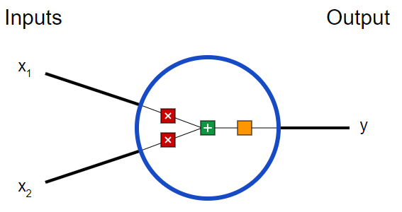
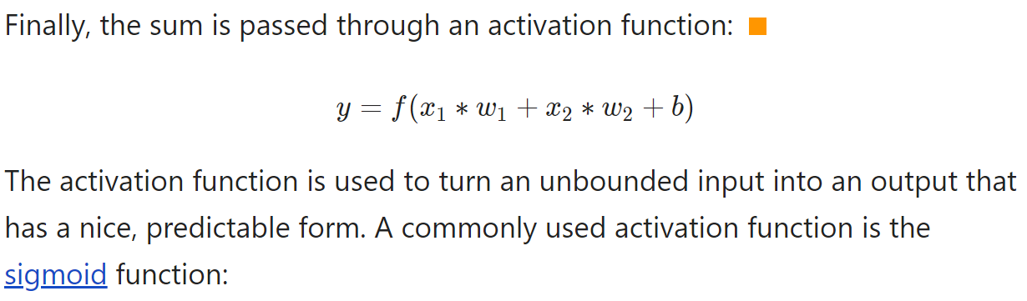
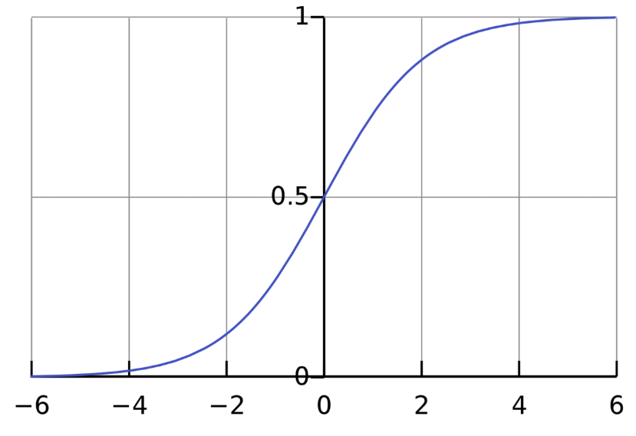
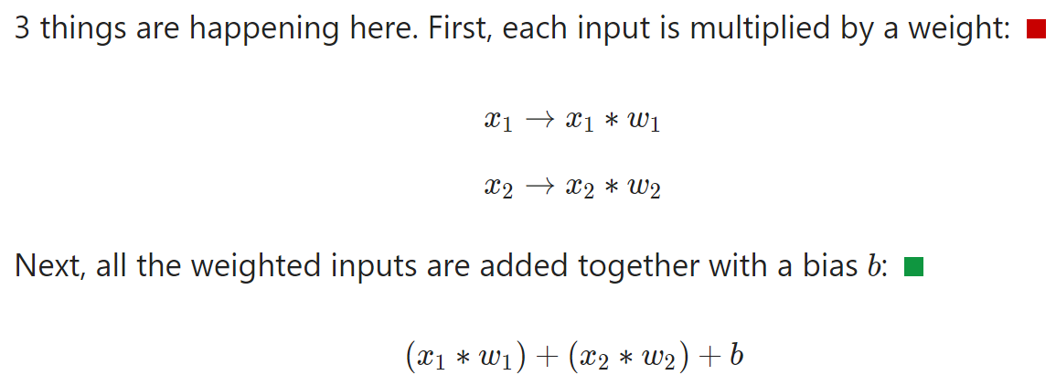
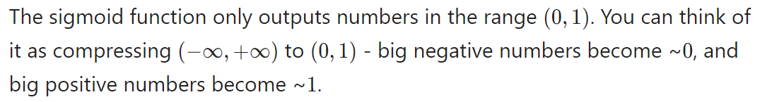
Background – Basic Neural Network Example
Source: https://victorzhou.com/blog/intro-to-neural-networks/
Notes:
A neuron takes inputs, does some math with them, and produces one output.

Slide 6
Limitations
Machine learning is being used in an increasing array of settings to make potentially security critical decisions:
self- driving cars, drones, robots, malware classification, speech recognition and many more.
Neural Networks are vulnerable to adversarial attacks. This makes it difficult to apply neural networks in security-critical areas.
Adversarial examples are close to the original. For example, if we use neural networks in self-driving cars, adversarial examples could allow an attacker to cause the car to take unwanted actions. It is possible to transform an image by a small amount and thereby change how the image is classified. Often, the total amount of change required can be so small as to be undetectable.

Slide 7
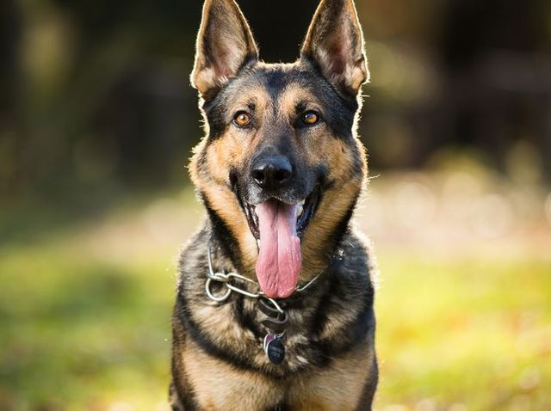
Adversarial Examples
For a classification neural network F(x)
Given input X classified as label L
Easy to find an X’ close to X
So that F(X’) = L
i.e. the network will identify the image on right as a cat.

Slide 8
Source: https://towardsdatascience.com/breaking-neural-networks-with-adversarial-attacks-f4290a9a45aa
Notes:
We start with an image of a panda, which our neural network correctly recognizes as a “panda” with 57.7% confidence. Add a little bit of carefully constructed noise and the same neural network now thinks this is an image of a gibbon with 99.3% confidence!

Slide 9
Source: https://towardsdatascience.com/breaking-neural-networks-with-adversarial-attacks-f4290a9a45aa
Notes:
The images shows real graffiti on a Stop sign, something that most humans would not think is suspicious. The right image shows a physical perturbation applied to a Stop sign. The systems classify the sign on the right as a Speed Limit: 45 mph sign! Source: Robust Physical-World Attacks on Deep Learning Visual Classification.

Slide 10
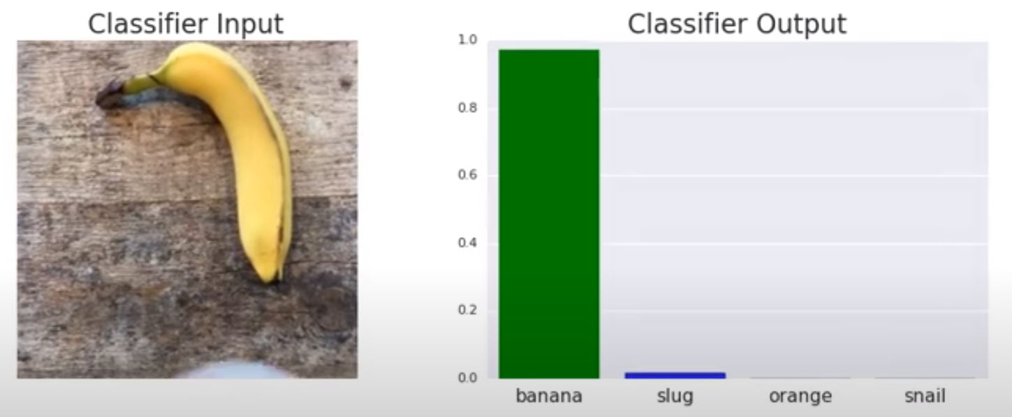
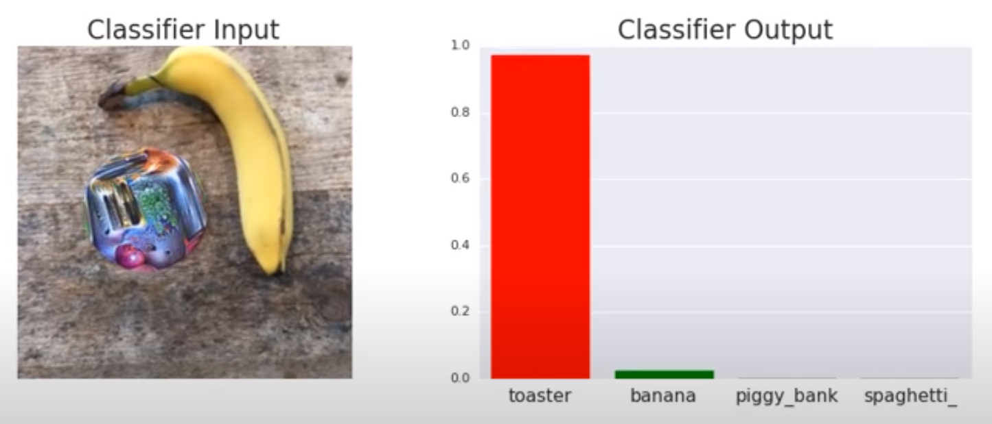
Source: https://towardsdatascience.com/breaking-neural-networks-with-adversarial-attacks-f4290a9a45aa

Slide 11
Defensive Distillation
Initial research proved to be very promising, defensive distillation defeated existing attack algorithms and reduced their success probability from 95% to 0.5%
However, Defensive distillation does not significantly increase the robustness of neural networks as stronger attack algorithms are introduced.
Defensive distillation can be applied to any feed-forward neural network and only requires a single re-training step and is currently one of the only defenses that gives only some security against adversarial examples.
More details about this later.
feed-forward neural: information only moves in one direction

Slide 12
Motivation
It is vital to find stronger defenses against adversarial attacks it can have catastrophic impacts.
To consider:
Defensive Distillation does not offer much defense against stronger attacks on distilled networks compared to un-distilled networks
Very easy for adversarial examples to obtain high confidence
Very little noise was added to fool the classifiers
An adversarial example trained for one network seems to confuse another one as well. This transferability enables attackers to fool systems in what are known as “black-box attacks” where they don’t have access to the model’s architecture, parameters or even the training data used to train the network.

Slide 13
Section 2
Current Research

Slide 14
Threat Model
We assume that the adversary has complete access to a neural network, including the architecture and all parameters, and can use this in a white-box manner. This is a conservative and realistic assumption
Prior work has shown it is possible to train a substitute model given black-box access to a target model, and by attacking the substitute model, we can then transfer these attacks to the target model.
Notes:
Black Box Testing is a software testing method in which the internal structure/ design/ implementation of the item being tested is not known to the tester.
White Box Testing is a software testing method in which the internal structure/ design/ implementation of the item being tested is known to the tester.

Slide 15
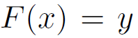
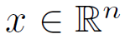
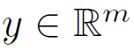
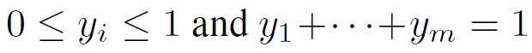
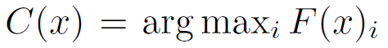
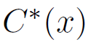
Neural Networks and Notation
A neural network is a function:
Accepts an input:
Produces as output:
In the paper, NN are used as an m-class classifier.
Output of the network is computed using the softmax function, which ensures that the output vector y satisfies
The output vector y is thus treated as a probability distribution, i.e., yi is treated as the probability that input x has class i.
The classifier assigns the label to the input x.
Let be the correct label of x.
The inputs to the softmax function are called logits.
m-class classifier problem of classifying instances into one of three or more classes
Source: Towards Evaluating the Robustness of Neural Networks [Nicholas Carlini and David Wagner]
Notes:
X is the input in the n-dimension and Y output in the m-dimension
Softmax function: a activation function that turns numbers aka logits into probabilities that sum to one. Softmax function outputs a vector that represents the probability distributions of a list of potential outcomes.
Activation function: turns an unbounded input into an output that has a nice, predicatable form.

Slide 16
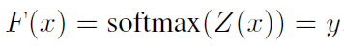
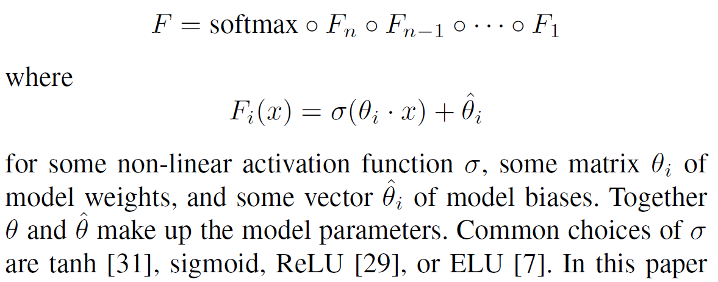
F(x) → Y
…
softmax function
y
argmax
function
C
n
m
F can be defined as a full neural network including the softmax function, Z(x) = z to be the output of all layers except the softmax (so z are the logits) and
A neural network typically consists of layers:
Source: Towards Evaluating the Robustness of Neural Networks [Nicholas Carlini and David Wagner]

Slide 17
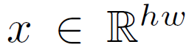
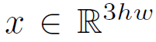
Neural Networks and Notation (continued)
Image Classification Domain
An h x w pixel grey-scale image is a two-dimensional vector where xi denotes the intensity of pixel i and is scaled to be in the range [0; 1].
A colour RGB image is a three-dimensional vector
We do not convert RGB images to HSV, HSL, or other cylindrical coordinate representations of colour images: the neural networks act on raw pixel values.
Source: Towards Evaluating the Robustness of Neural Networks [Nicholas Carlini and David Wagner]
Notes:
In RGB images, there are three channels that each can change. We count
the number of pixels that are different, where two pixels are considered
different if any of the three colors are different. We do not consider a
distance metric where an attacker can change one color plane but not another
meaningful. We relax this requirement when comparing to other L0 attacks
that do not make this assumption to provide for a fair comparison.

Slide 18
Adversarial Attack Types
Two types of Attacks:
Targeted Adversarial Attacks
Given a valid input x and a target t != C*(x) (correct label of x)
Find a similar input x’ such that C(x’) = t yet x, x’ are close to some distance metric.
Untargeted Adversarial Attacks
Less powerful than targeted attacks so not considered in the study
Instead of classifying the input x as a given target class, we only search for an input x’ so that
C(x’) != C*(x) and x, x’ are close.
Source: Towards Evaluating the Robustness of Neural Networks [Nicholas Carlini and David Wagner]

Slide 19
Distance Metrics
Three new attack algorithms that are successful on both distilled and un-distilled neural networks with 100% probability.
Goal of adversarial attacks is to make the x’ prime look close to x (original image) to the human eye.
Distance metrics are used to quantify similarity.
L0 distance measures the number of coordinates i such that xi != x’i
Corresponds to the number of pixels that have been altered in an image.
L2 distance measures the standard Euclidean (root-mean-square) distance between x and x’.
The L2 distance can remain small when there are many small changes to many pixels.
L∞ measures the maximum change to any of the coordinates:
For images, we can imagine there is a maximum budget, and each pixel is allowed to be changed by up to this limit, with no limit on the number of pixels that are modified.
Source: Towards Evaluating the Robustness of Neural Networks [Nicholas Carlini and David Wagner]

Slide 20
Distance Metrics
No distance metric is perfect measure of human perceptual similarity. Evaluating a good distance metric is an important research question that requires future work.
Most existing work has picked one of these three distance metrics, and since defensive distillation argues security against two of these, these distance metrics will be used to construct attacks that perform superior to the state-of-the-art.
All distance metrics will be reported on the range [0,1].
i.e. changing a pixel in a greyscale image from full-on to full-off will result in L2 change of 1.0 and L∞ change of 1.0, not 255.
Source: Towards Evaluating the Robustness of Neural Networks [Nicholas Carlini and David Wagner]
Notes:
L2 distance measures the standard Euclidean (root-mean-square) distance between x and x’.
The L2 distance can remain small when there are many small changes to many pixels.
L∞ measures the maximum change to any of the coordinates:

Slide 21
Attack Algorithms

Slide 22
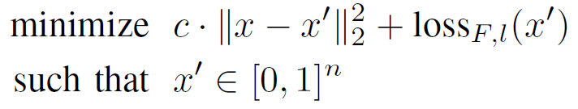
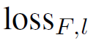
Existing Attack Algorithms (weak)
a. L-BFGS: Optimised for L2 distance metric
Given an image x, the method finds a different image x0 that is similar to x. Szegedy et al. solved the following problem:
c is a constant
||x – x’|| is a minimisation problem
is function mapping an image to a positive real number. Cross-entropy is a common loss function.
We repeatedly solve this optimization problem for multiple values of c, adaptively updating c using bisection search or any other method for one-dimensional optimization.
Loss Function: Measure of how accurate the network it. High number is not accurate and low number is accurate.
Source: Towards Evaluating the Robustness of Neural Networks [Nicholas Carlini and David Wagner]

Slide 23
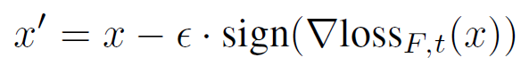
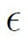
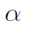
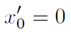
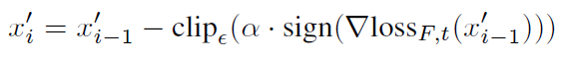
Existing Attack Algorithms
B. Fast Gradient Sign: Optimised for L∞ distance MetriC
Designed to be very fast instead of producing a very close adversarial example. Given an image x, the fast gradient sign method sets:
is sufficiently small so as to be undetectable
t is the target label
Intuitively, for each pixel, this method uses the gradient (∇) of the loss function to determine in which direction the pixel’s intensity should be changed (whether it should be increased or decreased) to minimize the loss function; then, it shifts all pixels simultaneously.
Iterative Gradient Sign
Kurakin et al. introduced a refinement
Instead of taking a single step of size in the direction of the gradient sign, multiple smaller steps are taken, the result is clipped by the same
Start by setting:
Then on each iteration:
Iterative Gradient Sign produces superior results to fast gradient sign.
Source: Towards Evaluating the Robustness of Neural Networks [Nicholas Carlini and David Wagner]
Notes:
E = epsilon
After starting, we calculate the loss value of each stem and make a small step called alpha.
So that it can be moved for evert stem as much as the size. Then, if it is outside the range of the image, clip it to erase the missing part.

Slide 24
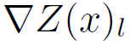
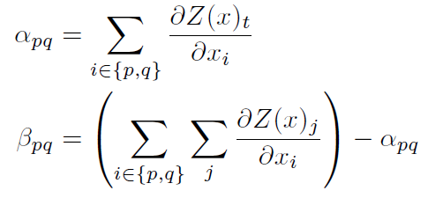
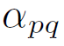
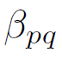
Existing Attack Algorithms
C. Jsma (Jacobian-based Saliency Map Attack): Optimised for L0 Distance metric
Algorithm picks pixels to modify one at a time, increasing the target classification on each iteration. They use the gradient to compute a saliency map, which models the impact each pixel has on the resulting classification.
A large value indicates that changing it will significantly increase the likelihood of the model labelling the image as the target class l.
Given the saliency map, it picks the most important pixel and modify it to increase the likelihood of class l. This is repeated until either more than a set threshold of pixels are modified which makes the attack detectable, or it succeeds in changing the classification.
We define the saliency map in terms of a pair of pixels p, q:
represents how much change both pixels p and q will change the target classification.
represents how much changing p and q will change all other outputs.
Source: Towards Evaluating the Robustness of Neural Networks [Nicholas Carlini and David Wagner]

Slide 25
Existing Attack Algorithms
D. Deepfool: Optimised for the l2 distance metric
Untargeted attack technique
Efficient and produces closer adversarial examples that L-BFGS
The authors construct Deepfool by imagining that the neural networks are totally linear, with a hyperplane separating each class from another. From this, they analytically derive the optimal solution to this simplified problem, and construct the adversarial example.
Then, since neural networks are not actually linear, they take a step towards that solution, and repeat the process a second time. The search terminates when a true adversarial example is found.
Source: Towards Evaluating the Robustness of Neural Networks [Nicholas Carlini and David Wagner]

Slide 26
Training Setup

Slide 27
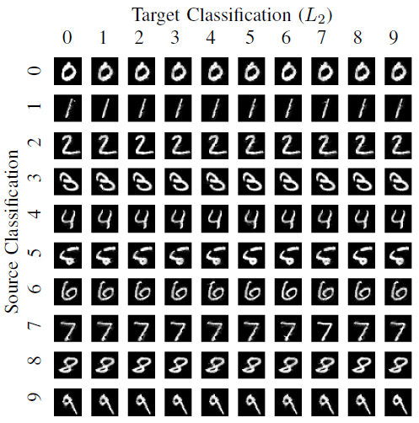
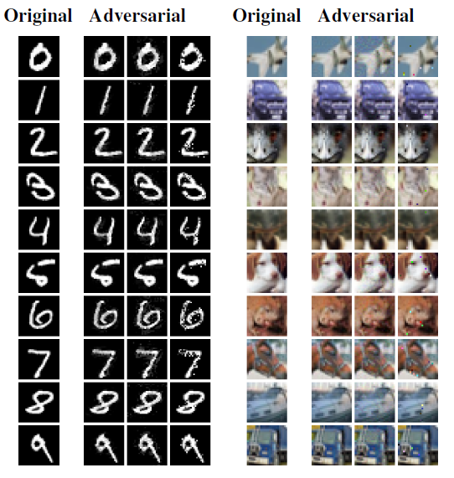
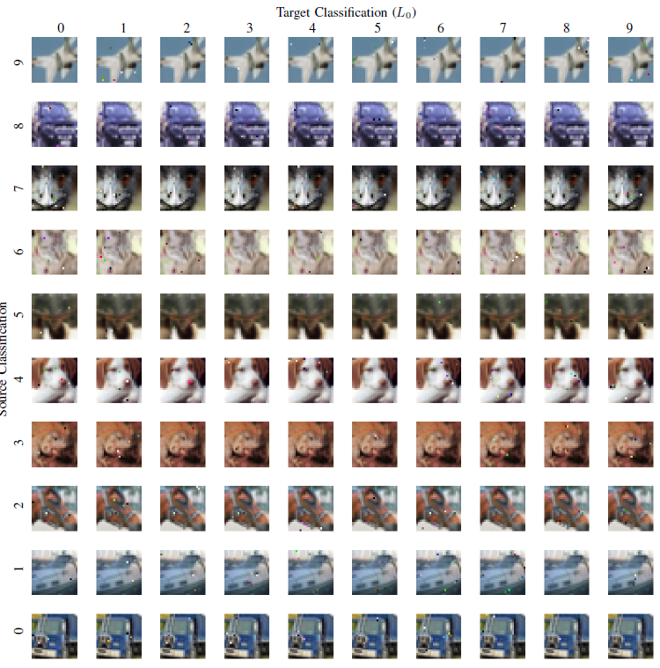
Training Setup – Data Sets
 | Data Set | Trained or Pre-Trained | Classification Accuracy
1 | MNIST | Trained | 99.5%
2 | CIFAR-10 | Trained | 80.0%
3 | ImageNet | Pre-Trained (Inception v3 network) | 96.0%
(1)
(2)
(3)
Source: Towards Evaluating the Robustness of Neural Networks [Nicholas Carlini and David Wagner]

Slide 28
Approach by Nicholas Carlini and David Wagner: Strong Attack Algorithm

Slide 29
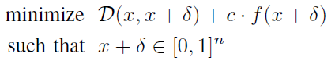
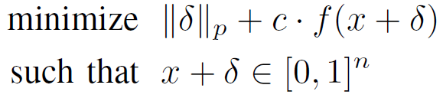
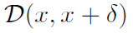
Strong Attack Algorithm
Define the problem of finding an adversarial instance for an image x as follows:
where x is fixed and the goal is to find that minimizes
We want to find a small change that we can make to an image x that will change its classification, so the result is still a valid image.
D is some distance metric.
C > 0 is a suitable constant (large value of c makes the attacks stronger)
After instantiating the distance metric D with an lp norm, the problem becomes: given x, find that solves:
Choosing the constant c
Use the smallest value of c for which the resulting solution x* has f(x*) <= 0. This causes gradient decent to minimise both the terms simultaneously instead of picking only one to optimise over first.
Source: Towards Evaluating the Robustness of Neural Networks [Nicholas Carlini and David Wagner]

Slide 30
The Three
Strong Attacks

Slide 31
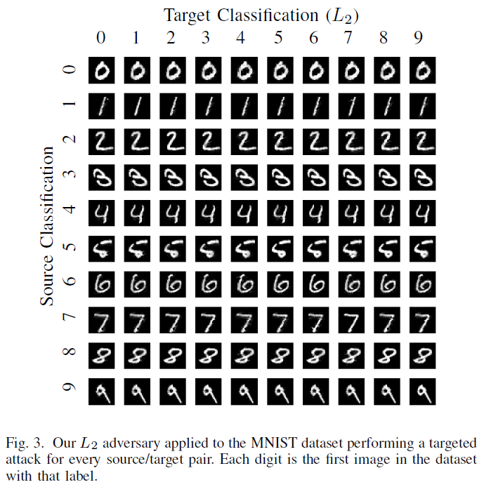
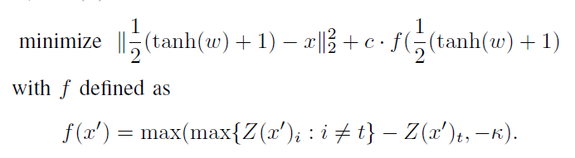
L2 Attack
To lower the distortion in the L2 metric
Given x, we choose a target class t (so that we have t != C*(x)) and then search for w that solves:
Value to k can be adjusted to make the attacks more powerful (more details on this later).
Result: Almost all attacks are visually indistinguishable from the original digit.
Source: Towards Evaluating the Robustness of Neural Networks [Nicholas Carlini and David Wagner]
Notes:
L2 distance measures the standard Euclidean (root-mean-square) distance between x and x’.
The L2 distance can remain small when there are many small changes to many pixels.

Slide 32

L0 Attack
The L0 distance metric is non-differentiable and therefore not suited for standard gradient descent.
Instead, iterative algorithm is used. In each iteration, it identifies some pixels that don’t have much effect on the classifier output and then fixes those pixels, so their value will never be changed.
The set of fixed pixels grows in each iteration until we have, by process of elimination, identified a minimal (but possibly not minimum) subset of pixels that can be modified to generate an adversarial example. In each iteration, we use our L2 attack to identify which pixels are unimportant.
Source: Towards Evaluating the Robustness of Neural Networks [Nicholas Carlini and David Wagner]
Notes:
L0 distance measures the number of coordinates i such that xi != x’i
Corresponds to the number of pixels that have been altered in an image.

Slide 33
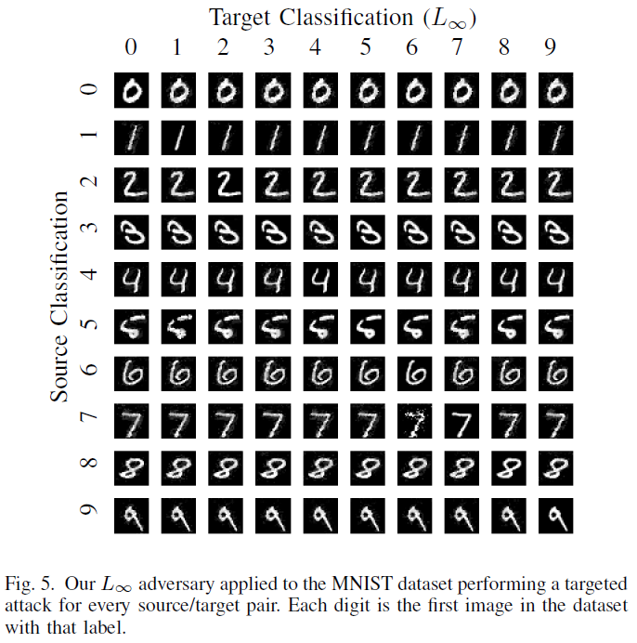
L∞ Attack
The L∞ distance metric is not fully differentiable and standard gradient descent does not perform well for it.
Result: most differences are not visually noticeable, a few are. the worst case is that of a 7 being made to classify as a 6.
Source: Towards Evaluating the Robustness of Neural Networks [Nicholas Carlini and David Wagner]
Notes:
L∞ measures the maximum change to any of the coordinates

Slide 34
Attack Evaluation

Slide 35
Attack Evaluation
Comparing the new targeted attacks to the best previously reported results:
Success: if the attack produced an adversarial example with the correct target label, no matter how much change was required.
Failure: Attack was entirely unable to succeed.
Attacks find closer adversarial examples than the previous state-of-the-art attacks, and new attacks never failed to find an adversarial example.
L0 and L2 attacks find adversarial examples with 2x to 10x lower distortion than the best previously published attacks, and succeed with 100% probability.
L∞ attacks are comparable in quality to prior work, but their success rate is higher. L∞ attacks on ImageNet are so successful that can change the classification of an image to any desired label by only flipping the lowest bit of each pixel, a change that would be impossible to detect visually.
Source: Towards Evaluating the Robustness of Neural Networks [Nicholas Carlini and David Wagner]

Slide 36
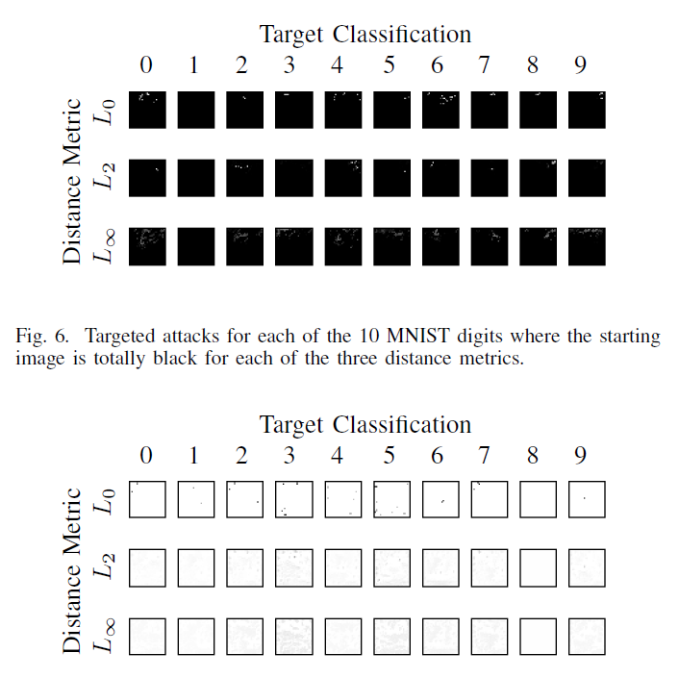
Generating synthetic digits
Attacks were so powerful that any image can be used to find adversarial examples for each given target. Starting with entirely black or white image.
Source: Towards Evaluating the Robustness of Neural Networks [Nicholas Carlini and David Wagner]

Slide 37
Evaluating Defensive Distillation

Slide 38
Defensive Distillation
Distillation was initially proposed as an approach to reduce a large model (the teacher) down to a smaller distilled model.
Distillation works by first training the teacher model on the training set in a standard manner. Then, we use the teacher to label each instance in the training set with soft labels (the output vector from the teacher network).
i.e. the hard label for an image of a hand-written digit 7 will say it is classified as a seven, the soft labels might say it has a 80% chance of being a seven and a 20% chance of being a one.
Then, we train the distilled model on the soft labels from the teacher, rather than on the hard labels from the training set.
Source: Towards Evaluating the Robustness of Neural Networks [Nicholas Carlini and David Wagner]
Notes:
soft labels = has a score (probability or likelihood)

Slide 39
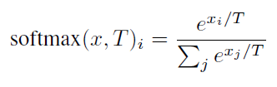
Defensive Distillation
Defensive distillation uses distillation in order to increase the robustness of a neural network, but with two significant changes. First, both the teacher model and the distilled model are identical in size — defensive distillation does not result in smaller models. Second, and more importantly, defensive distillation uses a large distillation temperature to force the distilled model to become more confident in its predictions.
Recall that, the softmax function is the last layer of a neural network. Defensive distillation modifies the softmax function to also include a temperature constant T:
It is easy to see that softmax(x, T) = softmax(x/T, 1). Increasing the temperature causes a “softer” maximum, and decreasing it causes a “harder” maximum. As the limit of the temperature goes to 0, softmax approaches max; as the limit goes to infinity, softmax(x) approaches a uniform distribution.
Source: Towards Evaluating the Robustness of Neural Networks [Nicholas Carlini and David Wagner]

Slide 40
Steps of Defensive Distillation
1) Train a network, the teacher network, by setting the temperature of the softmax to T during the training phase.
2) Compute soft labels by apply the teacher network to each instance in the training set, again evaluating the softmax at temperature T.
3) Train the distilled network (a network with the same shape as the teacher network) on the soft labels, using softmax at temperature T.
4) Finally, when running the distilled network at test time (to classify new inputs), use temperature 1.
Source: Towards Evaluating the Robustness of Neural Networks [Nicholas Carlini and David Wagner]

Slide 41
Defensive Distillation with new attacks
When we apply new attacks to defensively distilled networks, we find distillation provides only marginal value. We re-implement defensive distillation on MNIST and CIFAR-10 as described using the same model we used for our evaluation above. Distilled model with temperature T = 100, the value found to be most effective.
Source: Towards Evaluating the Robustness of Neural Networks [Nicholas Carlini and David Wagner]

Slide 42
Transferability

Slide 43
Transferability
Recent work shows that an adversarial example for one model will often transfer to be an adversarial on a different model, even if they are trained on different sets of training data and even if they use entirely different algorithms.
Therefore, any defence that is able to provide robustness against adversarial examples must somehow break this transferability property; otherwise, we could run our attack algorithm on an easy-to-attack model, and then transfer those adversarial examples to the hard-to-attack model.
Even though defensive distillation is not robust to the new stronger attacks, it was demonstrated that a second break of distillation by transferring attacks from a standard model to a defensively distilled model.
Source: Towards Evaluating the Robustness of Neural Networks [Nicholas Carlini and David Wagner]

Slide 44
Transferability
Recall the loss function defined earlier for L2 attacks:
The purpose of the parameter K is to control the strength of the adversarial examples:
Larger the k, the stronger the classification of adversarial example.
The transferability success rate increases linearly from k = 0 to k = 20 and then plateaus at near-100% success for k ~ 20, so clearly increasing k increases the probability of a successful transferable attack.
We then run this same experiment only instead we train the second model with defensive distillation, and find that adversarial examples do transfer. This gives us another attack technique for finding adversarial examples on distilled networks.
However, interestingly, the transferability success rate between the unsecured model and the distilled model only reaches 100% success at = 40, in comparison to the previous approach that only required = 20.
Source: Towards Evaluating the Robustness of Neural Networks [Nicholas Carlini and David Wagner]

Slide 45
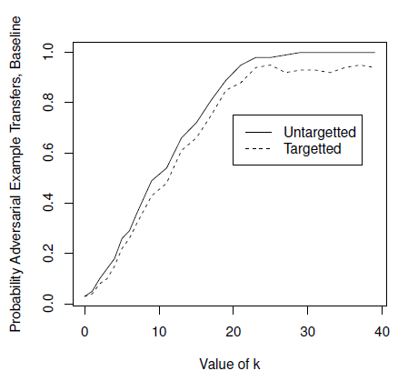
Source: Towards Evaluating the Robustness of Neural Networks [Nicholas Carlini and David Wagner]

Slide 46
Conclusion
How to evaluate a defense?
Release source code
Other people can evaluate your defenses
Demonstrate that transferability fails
Construct high-confidence adversarial examples on a unsecured model and show they fail to transfer to the secured model.
Evaluate against the strongest attacks as a baseline
Robustness against weak attacks is useless

Slide 47
References
Towards Evaluating the Robustness of Neural Networks [Nicholas Carlini and David Wagner]
https://towardsdatascience.com/breaking-neural-networks-with-adversarial-attacks-f4290a9a45aa
https://victorzhou.com/blog/intro-to-neural-networks/

